Slide 1

CASE MANAGEMENT PLATFORM
“AUTOMATED MEDIATOR”

Slide 2

CASE MANAGEMENT PLATFORM
“AUTOMATED MEDIATOR”
ONLINE DISPUTE RESOLUTION (ODR)
AUTOMATED CASE MANAGEMENT
CENTRALISED CASE FILE ACCESS SYSTEM
ACCESS TO RELEVANT DOCUMENTS AT THE HQ
TRACKING AND MONITORING OF CASES
AUTOMATED REPORTING SYSTEM(monthly, quarterly, yearly by each location)

Slide 3





CMC LAGOS-ISLAND
CMC IKOTUN
CMC IKORODU
CMC IBA
CMC AGEGE
CMC YABA
CENTRAL CASE MANAGER CMC HQ
CMC OSHODI
CMC EPE
CMC AMUKOKO
CMC ALIMOSHO
CMC OJOKORO
CMC BARIGA
CMC EREDO
CMC IBEJU-LEKKI
CMC BADAGRY
FLOW OF INFORMATION BTW. HQ AND BRANCH OFFICES

Slide 4
DRAFT CASE ASSIGNMENT/ MEDIATION SCHEDULING
CMC HQ
CMC IKOTUN
CMC EPE
CMC IKORODU
* ALL PETITIONS/MATTERS ASSIGNED TO COUNSEL FROM THE HQ * PETITION RECEIVED AT BRANCHES MUST BE REPORTED 1ST AT HQ FOR PROPER CASE MANAGEMENT
CMC OJOKORO
CMC EREDO
ALIMOSHO
CMC YABA
CMC BADAGRY
CMC IBEJU-LEKKI

Slide 5
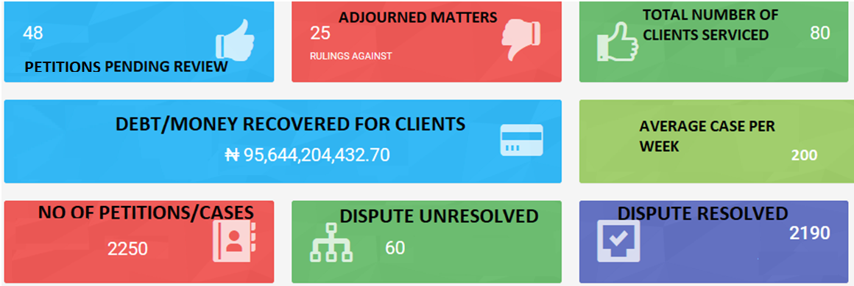
SAMPLE CASE MANAGEMENT DASHBOARD

Slide 6
THANK YOU

